Slide 1

Bluetooth Detective
By
Jessica Forrett, Ivan Martinovic, and Anna Cherkinsky

Slide 2

BluetoothDetective
Device which helps the user find Bluetooth-connective items through a mobile device.
Uses an app with camera view to allow the user see where the object they are looking for is located.
The BluetoothDetective can catch signals from Bluetooth devices using certain modules.
  It can also determine the distance of the device one is looking for from where the device with the app is located.
    The device used to search would also be connected to BluetoothDetective via Bluetooth.

Slide 3
Physical Design: Original
Container holding the Bluetooth Modules
Attached to the phone using phone holder used in cars

Slide 4
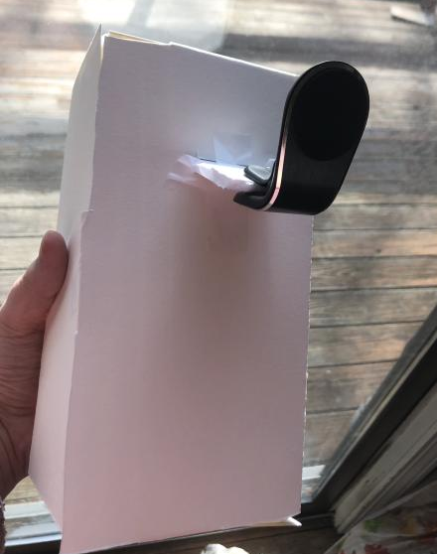
Watercolor Paper Prototype
Not sturdy enough
Uncomfortable to hold

Slide 5
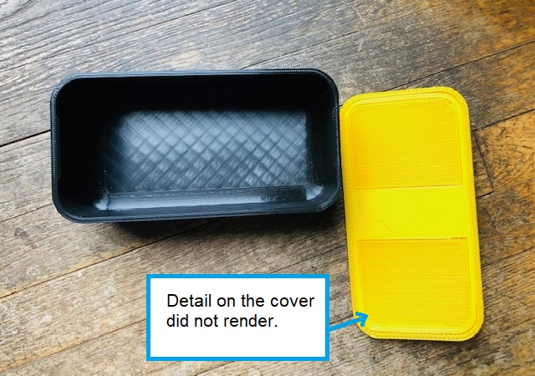
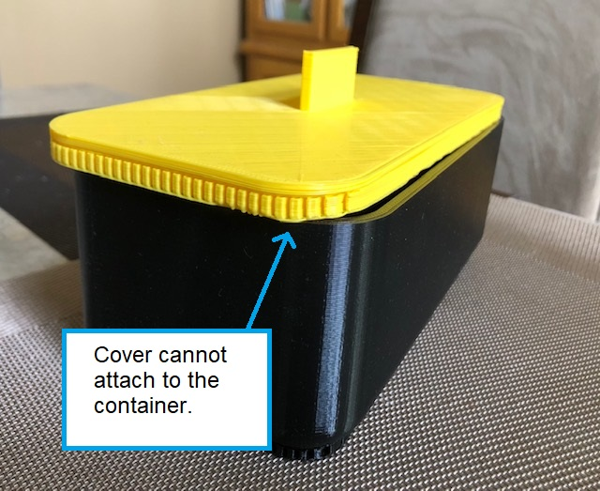
3D Print: Fail
Did not render correctly

Slide 6
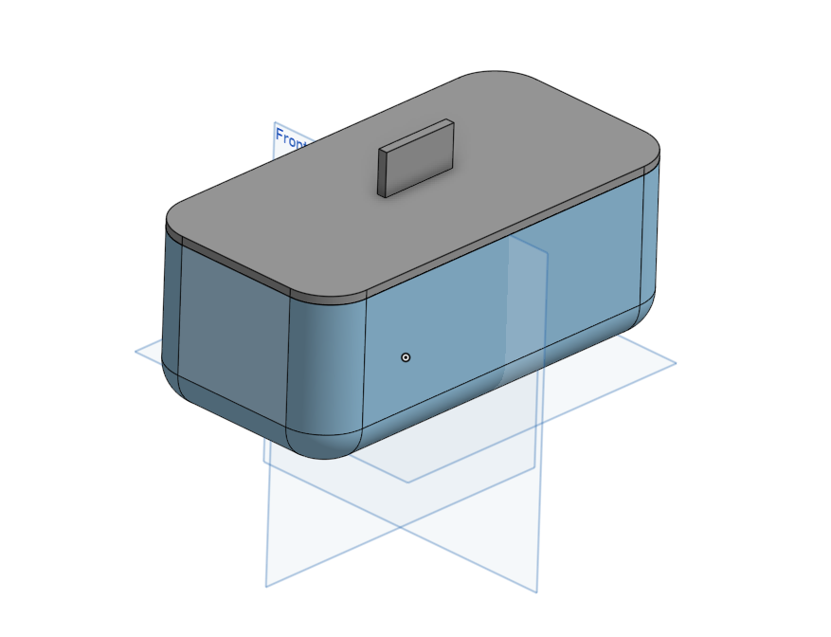
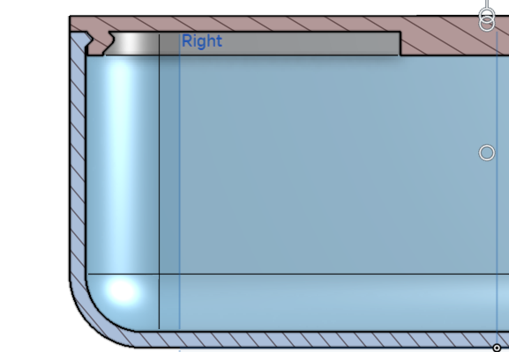
Lessons from 3d Print
How to use 3dPrinterOS
How to pay and recieve the print at WPI
Onshape

Slide 7
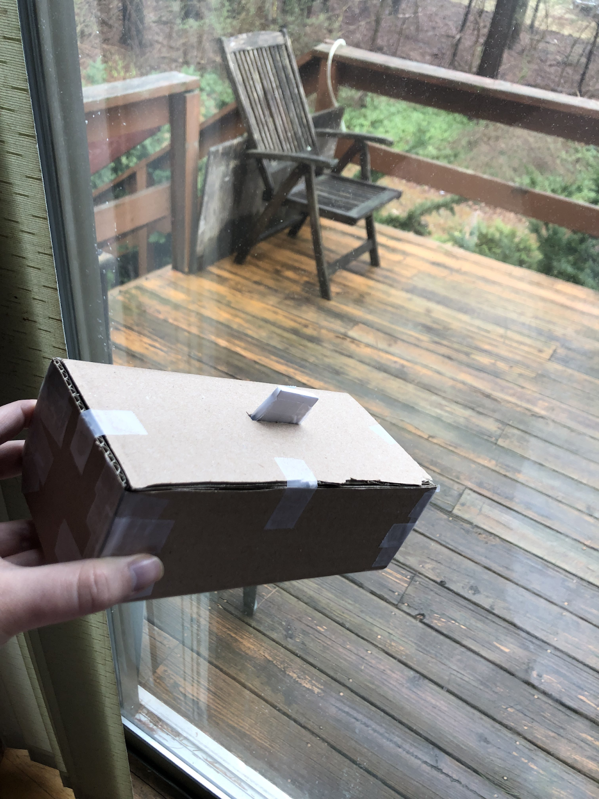
Back-up plan: Cardboard box
Sturdier than watercolor paper

Slide 8
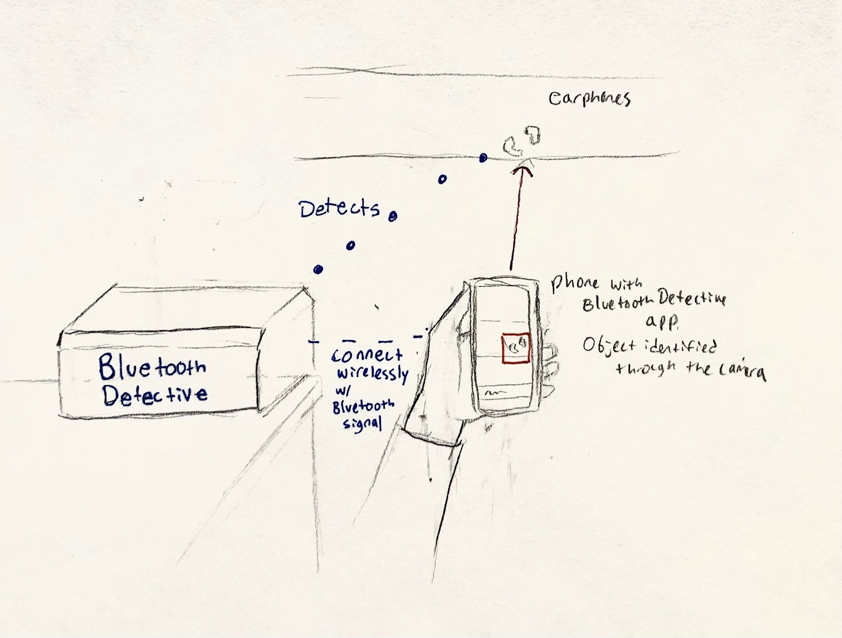
Physical design: reimagined
Our cardboard box design was too heavy for users
Too large
We decided that it should be stationary

Slide 9
Digital Design

Slide 10
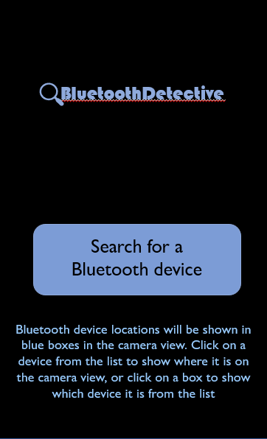
HOME SCREEN

Slide 11
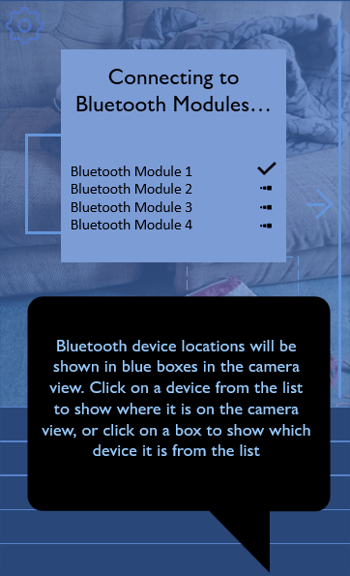
LOADING SCREEN

Slide 12
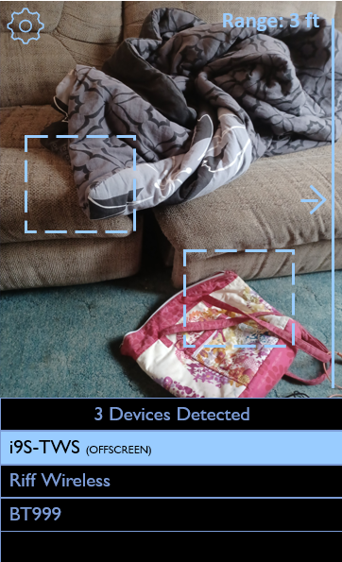
CAMERA VIEW

Slide 13
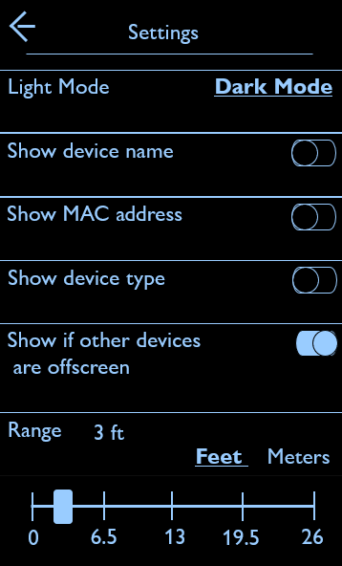
SETTINGS MENU

Slide 14
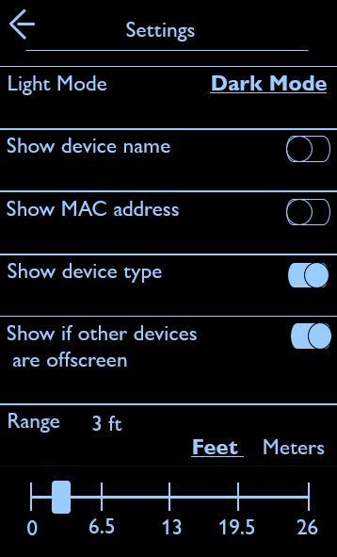
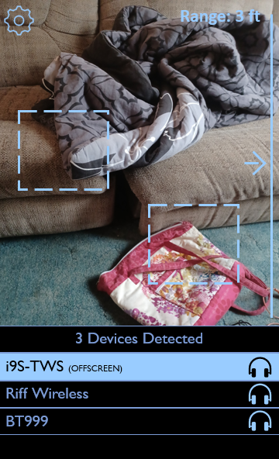

Slide 15
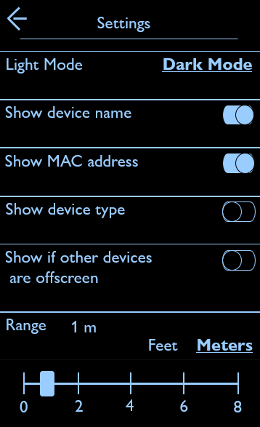
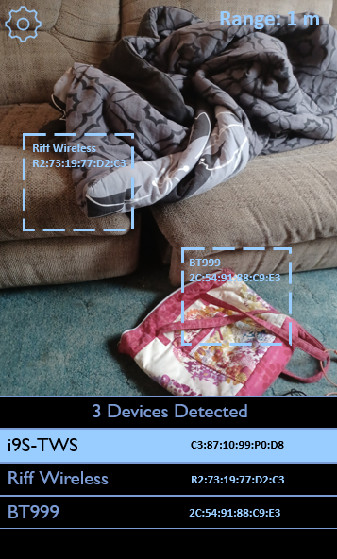

Slide 16
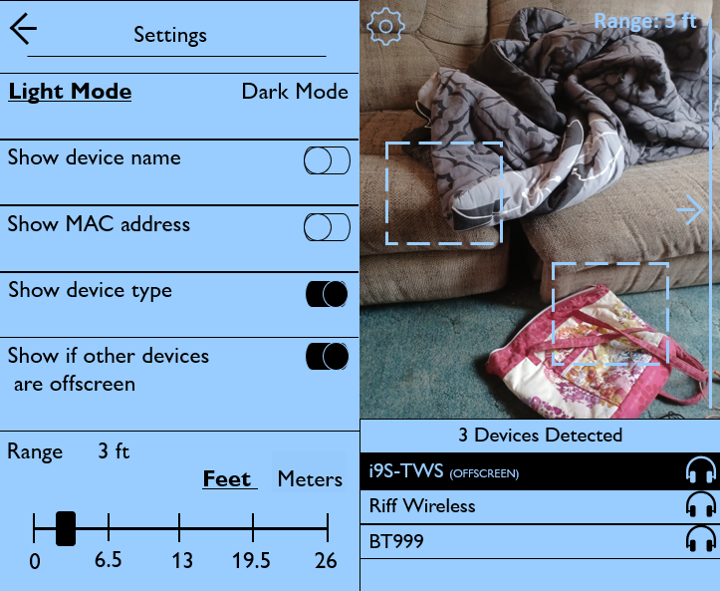

Slide 17
Electronic Components

Slide 18
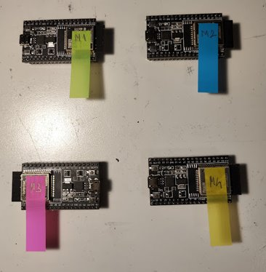

ESP-32 Modules
Development Board
Has Wi-Fi and Bluetooth Capabilities
Programmed in C++

Slide 19
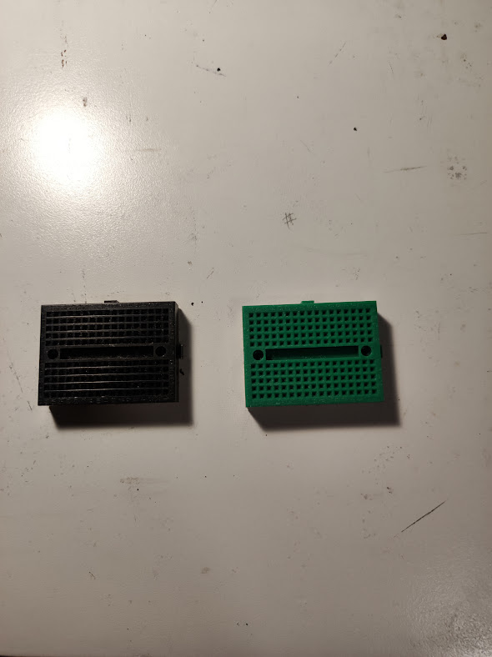
Breadboards
Roughly same size as the ESP-32 Modules
Used to secure the modules

Slide 20
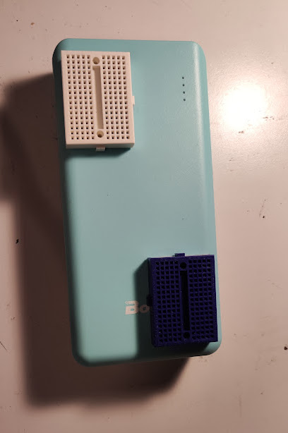
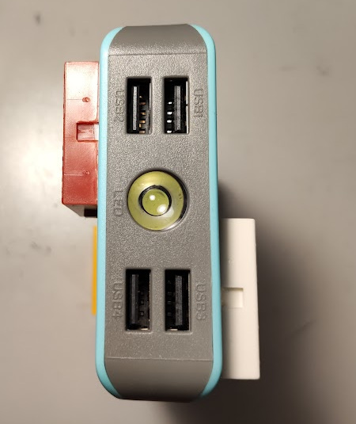
Power bank
Has 4-way output
Outputs 5 Volts
Breadboards were initially planned to be stuck to it

Slide 21
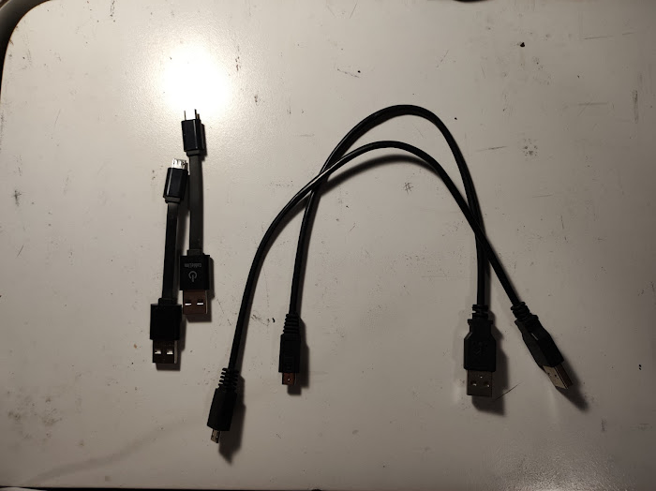
USB to USB-c cables
For connecting modules to power bank
2 Short and 2 Long Cables
Easy and reliable power supply connection

Slide 22
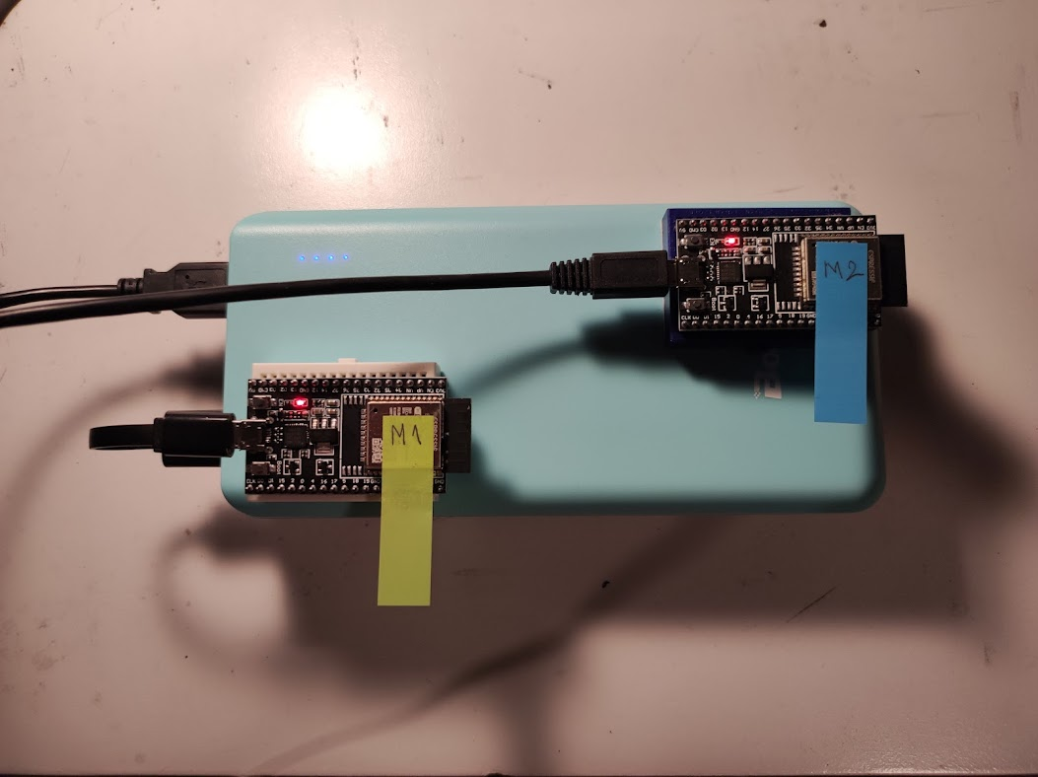
Preview of the entire electronic system

Slide 23
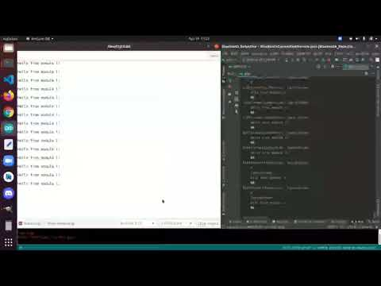
Accomplishment #1: Basic One-way communication

Slide 24
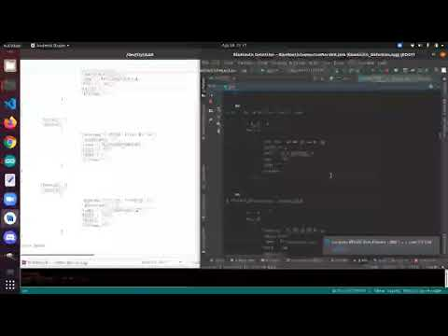
Accomplishment #2: Multiple-two way communication - Sending Signal Strength Information

Slide 25
Thank You!

